Slide 1
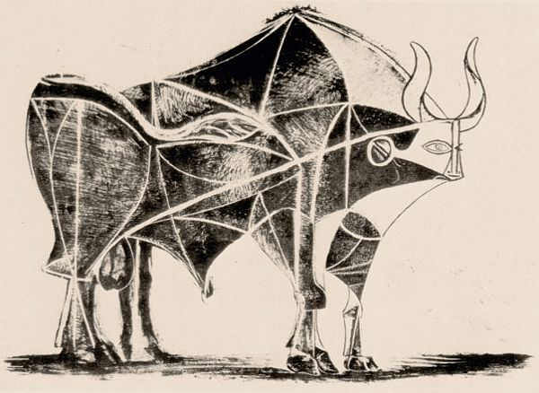
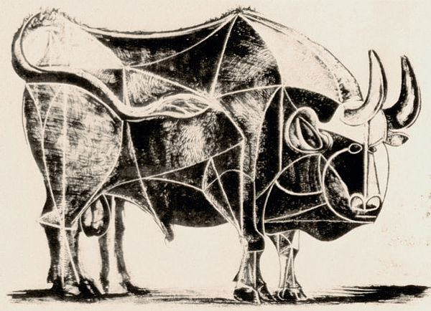
Picasso’s Bull Transformation 3 → 4
CS260 Image Processing, Fall 2020

Slide 2
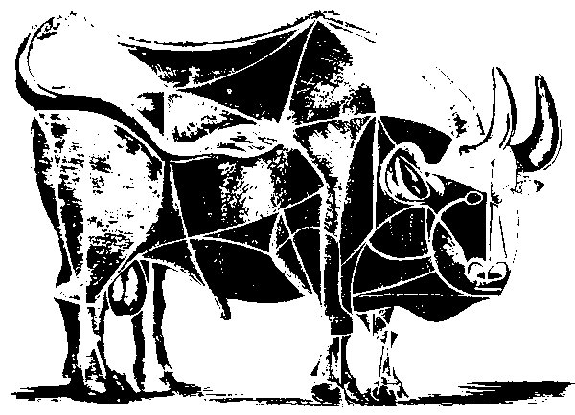
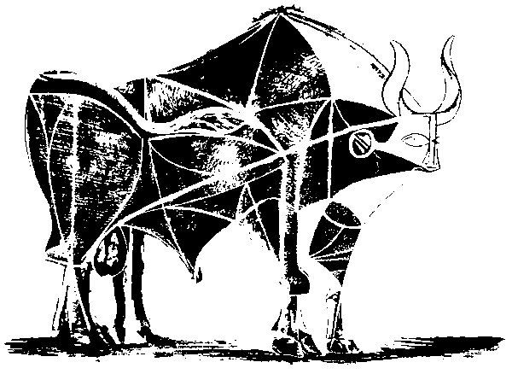
Step 1: Make grayscale → Binarize

Slide 3
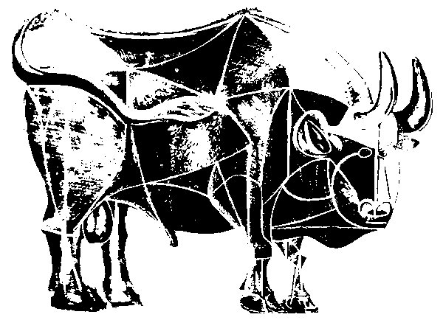
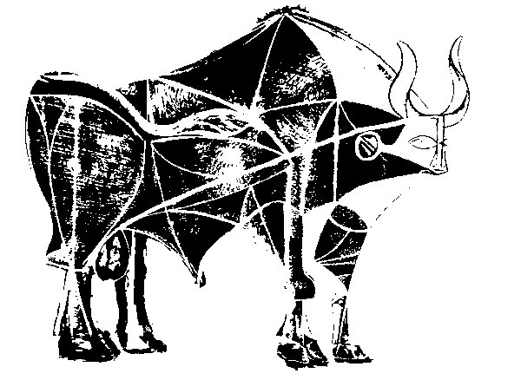
Step 2: Remove ground

Slide 4
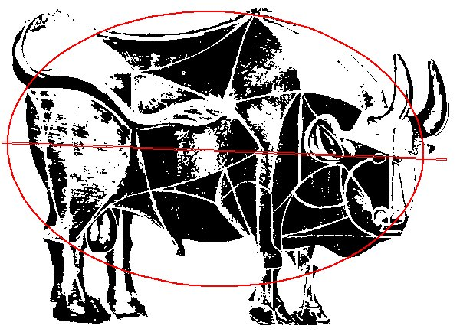
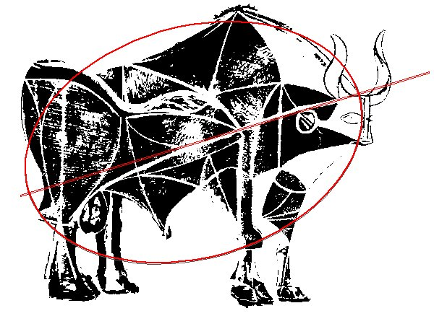
Step 3: Visualize the measures
↓

Slide 5

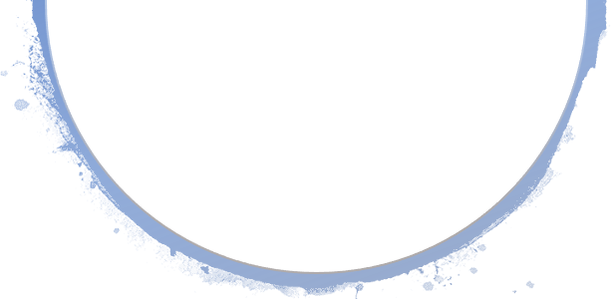
Step 3 explanation
In step 4 above, I have manually selected the outlining polygn of the bulls and interpolated it to get a smoother perimeter.
I then used that curve to fit an ellipse and visualized the axis.
It is visible, that there is an apparent difference between the “directions” of the two bulls.
My hypothesis is that Picasso tried to change the direction of the somewhat downward-inclined bull of plate 3 to a more above-seeking pose.
↓

Slide 6
↓
Another hypothesis that I have is that the downward-inclined feeling of the first bull is transferred not only by the direction of the axis of the ellipse, but also by the center of mass of the bull.
The first bull plate sems to be more right-heavy than the second one. The feeling is that Picasso tried to “lift” the bull and blance it.
If we drew a vertical line at the middle of both plates, I would expect the center of mass of the first bull to be righter from the line then that of the second plate.

Slide 7
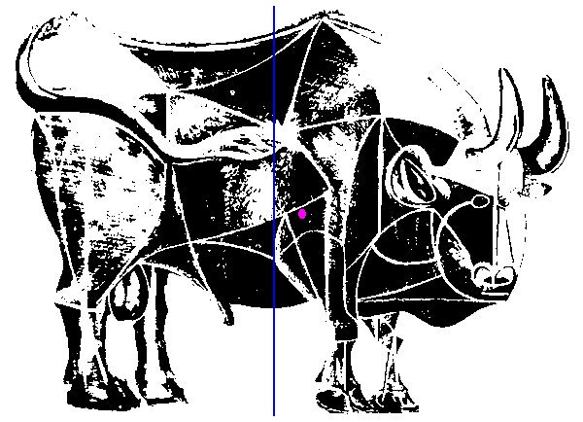
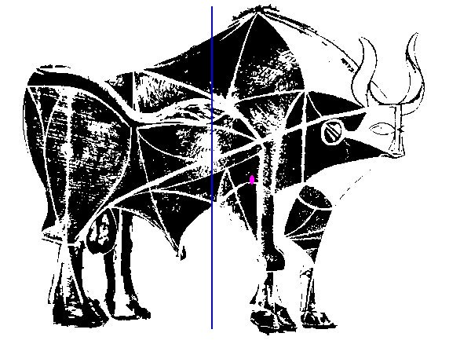
Step 4: Measure the center of mass

Slide 8
Step 4 discussion
Unlike my expectations, the center of mass calculated by ImageJ did not reflect the heaviness perceprions that I have.
This might be because either the pixel colors are not taken into account when calculating the center of mass, or white pixels contribute more to the weight.
The first option might be more probable, because otherwise the center of mass would be the reflection of the current point against the central blue line, which would be even more weird.

Slide 9
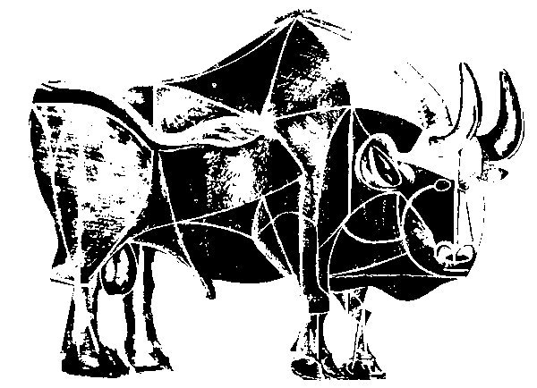
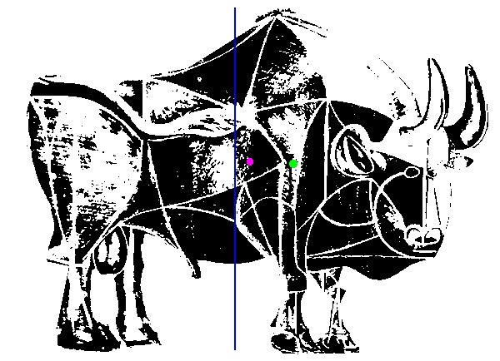
Step 5: Removed parts

Slide 10
Step 5 discussion
As discovered in entry 1, some parts of the plate 3, such as the lower back and the tail are simply cut out.
After cutting those parts out, I measured the (wrong) center of mass again (magenta), and for some alien reason it went even closer to the blue line.
Nevertheless, my perceprion of the center of mass id the green dot, and I think the further deletions from the frontal part are done to bring the center of mass back to the blue line.

Slide 11
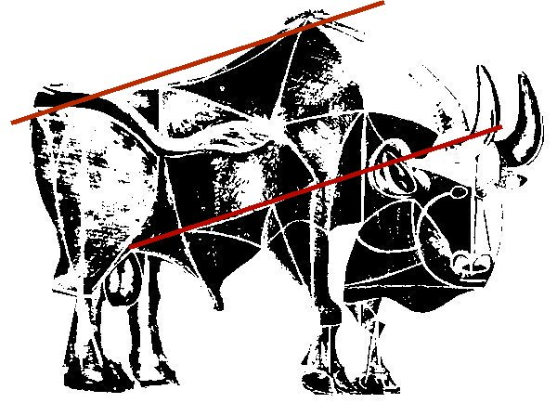
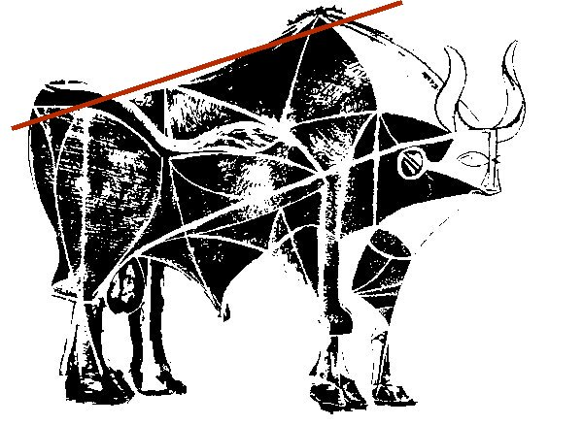
Step 6: Spine and the new central line

Slide 12
Step 6 explanation
My hypothesis is that in order to “straghten” the pose of the bull, all the body is “built” parallel to the spine, which is the most central part of the posture.
Thus, I suspected that the new bold line was added to assist this mission.
Turns out, the bold central line is indeed parallel to the spine, and connects the legs of the animal to the point where the head should be.
That is exactly how I went on creating the new central line.

Slide 13
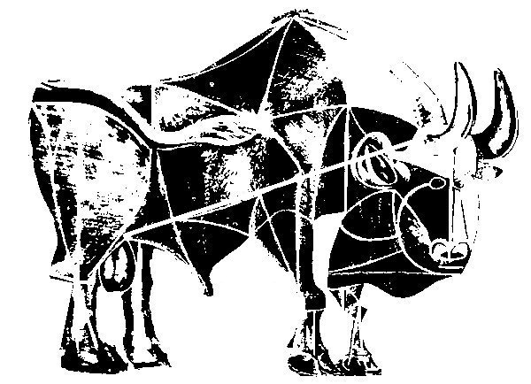
Step 6: Spine and the new central line

Slide 14
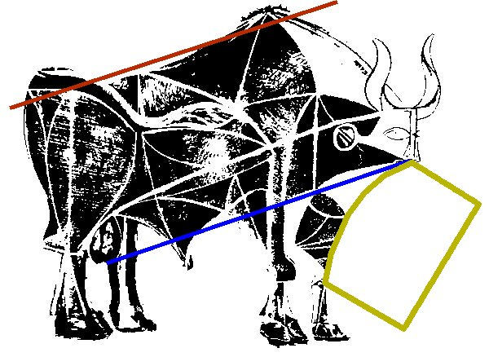
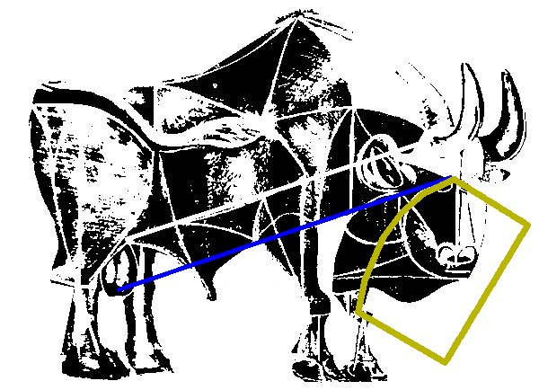
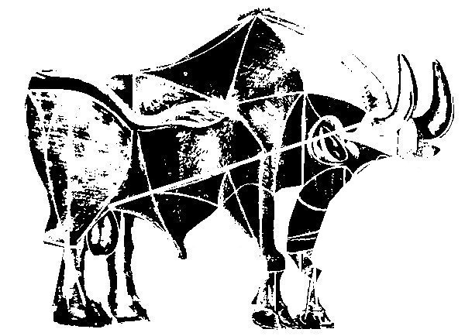
Step 7: Further deletions

Slide 15
Step 8: Comparing center of mass again

Slide 16
Step 9: The head is simply removed and drawn again.

Slide 17
Step 9: The head is simply removed and drawn again.

Slide 18
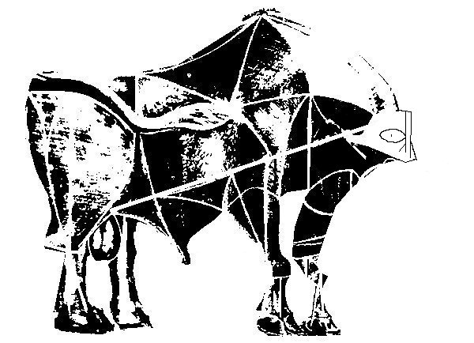
Step 9: The head is simply removed and drawn again.

Slide 19
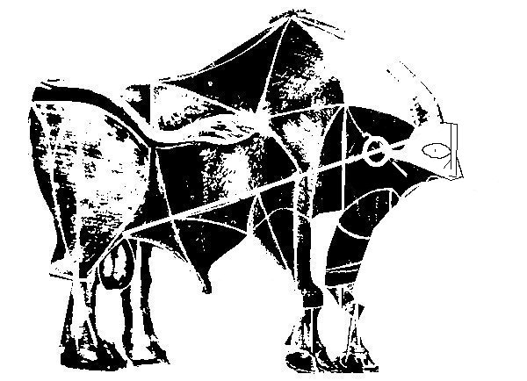
Step 10: The ear is drawn as an oval, at the intersection of the head, central line and the under-ear line.

Slide 20
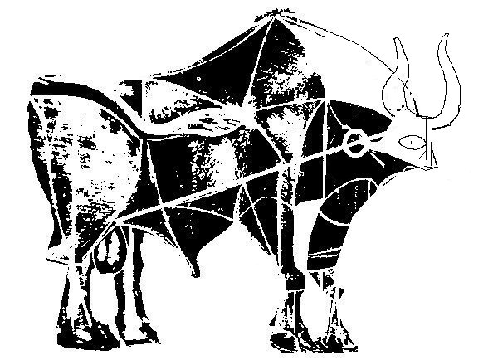
Step 11: Now, it’s time for the glorious new horns.
This was the most glorious I could…

Slide 21
Step 12: Front leg corrections and the middle leaf-like structure that outlines the ribs.

Slide 23
